Slide 1
2015 Math & Steam Conference

Slide 2
Pick up Folder-Thanks, Lisa & Lynn
Have a Bagel & Coffee-Thanks, Ali
Get Units, Thanks, Dale
Meet your Presenters, Thanks, all
Meet your keynoter, Thanks, Jo!
Log on, thanks, Mary Ann & tech
Evaluations at 1:00 online
Swap meet open until 2:00

Slide 3
(Mary Ann will now point dramatically to the restrooms...)

Slide 4
Where do we fit in?
NCTM
CMC
CMCNorth
CMCFarNorth

Slide 5
What can CMCFN do for you?
Annual Conference-amazing keynotes
Networking-start today
Sign up on poster for PM collaborations
Website www.cmcfn.com
Local support from local experts

Slide 6
Grants & Scholarships–under the Resources tab cmcfn.com
Collaboration Grant–up to $250-
Scholarships – 2 for CMCN Asilomar $500 ea. Drawing at 1:45
Everyday Hero –nominate a pal

Slide 7
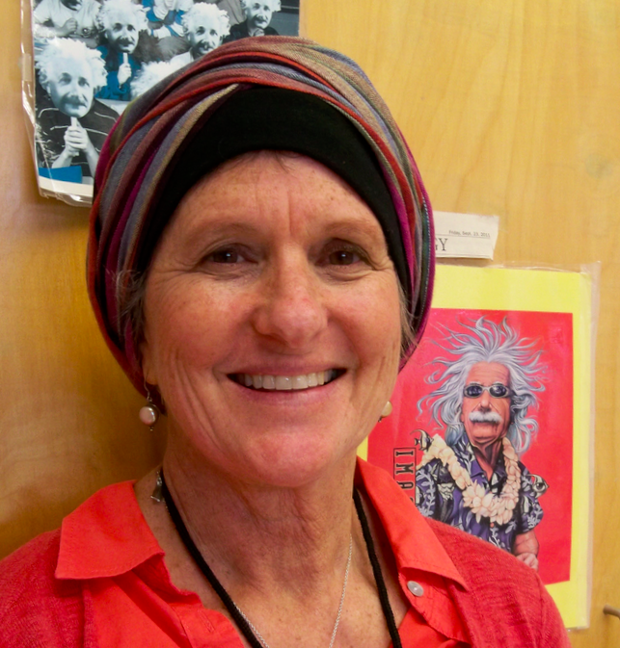
One everyday hero: Laura Grant
It is the supreme art of the teacher to awaken joy in creative expression and knowledge.
Albert Einstein

Slide 8
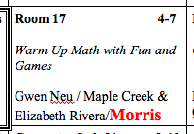
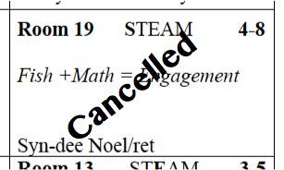
Program Corrections:

Slide 9
After Breakout C
Back to the Gym 1:05 pm
AM Closing
Evaluations-QR code or tiny url or website
Prizes Asilomar & EDH (links on cmcfn.com)
Lunch for full day registration.
1:45 collaboration sessions begin

Slide 10
THANK YOU
To this year’s sponsors:
HISI grant & Michael Kauffman,
HSU Dept of Ed & Mary Dingle,
RAMP & Dale Oliver,
HCOE & Cathy Dickerson,
DNCOE & Rae Fearing,
and Starbucks, for the coffee!

Slide 11
Please mingle & Dr. Jo Boaler will begin at 9:00
(Beth will now stop talking...)

